Slide 1

BANKING : CUSTOMER 360* DASHBOARD
PRESENTED BY: JASMEEN KAUR (72513562)
BALRAJ SINGH CHHINA (72510266)
PRABHJOT KAUR CHHINA (72510265)
GURSIMRAN KAUR (72514677)

Slide 2
INTRODUCTION
Modern banking is becoming more digital and customer focused.
To provide better service, banks need a full picture of each customer.
A customer 360 dashboard helps banks collect, analyze, and visualize all customer information in one place.

Slide 3
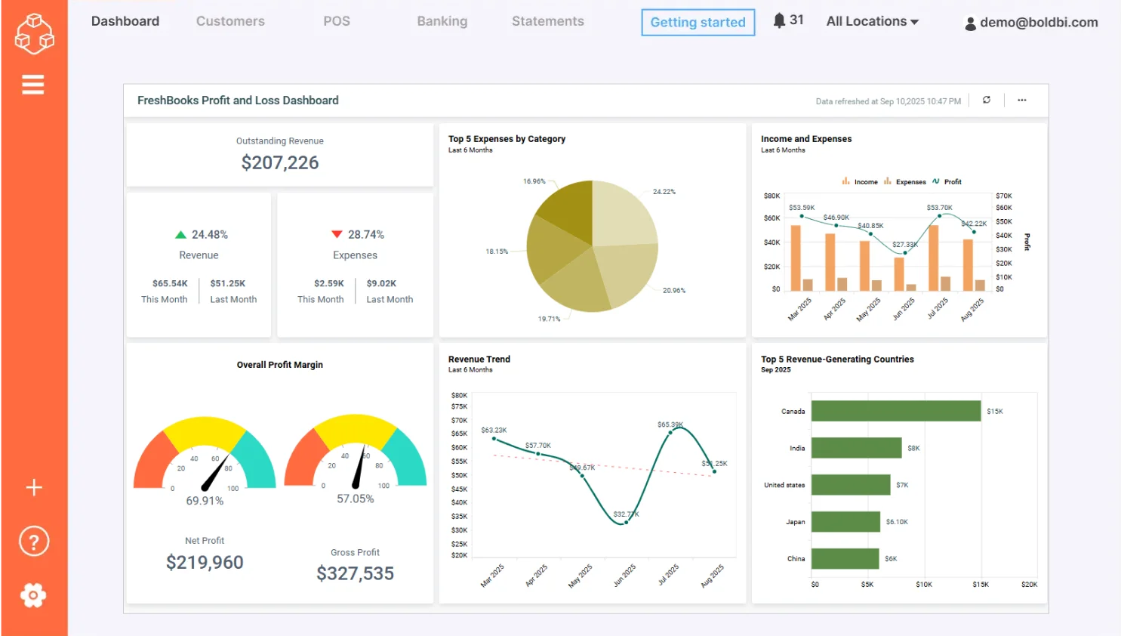
MEANING OF CUSTOMER DASHBOARD
A single unified view of a customer’s entire relationship with the bank.
Combines data from multiple sources such as : ACCOUNTS, LOANS, TRANSACTIONS
Helps the bank understand customer needs and behaviour.

Slide 4
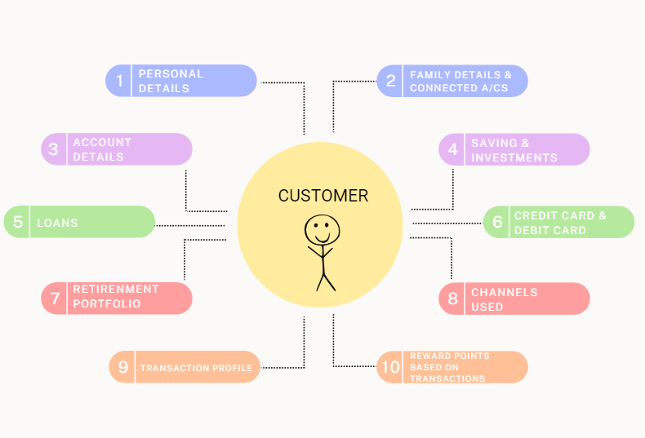
KEY FEATURES
CUSTOMER PROFIT
ACCOUNT SUMMARY
TRANSACTION HISTORY
LOAN & CREDIT DETAILS
PREDICTIVE ANALYTICS
CUSTOMER INTERACTION HISTORY

Slide 5
WHY DO BANK NEED IT?
Enhance customer experience
Speeds up decision making
Helps in fraud detection
Improves relationship management
Supports cross selling and upselling
Enables personalised banking services
WHY

Slide 6
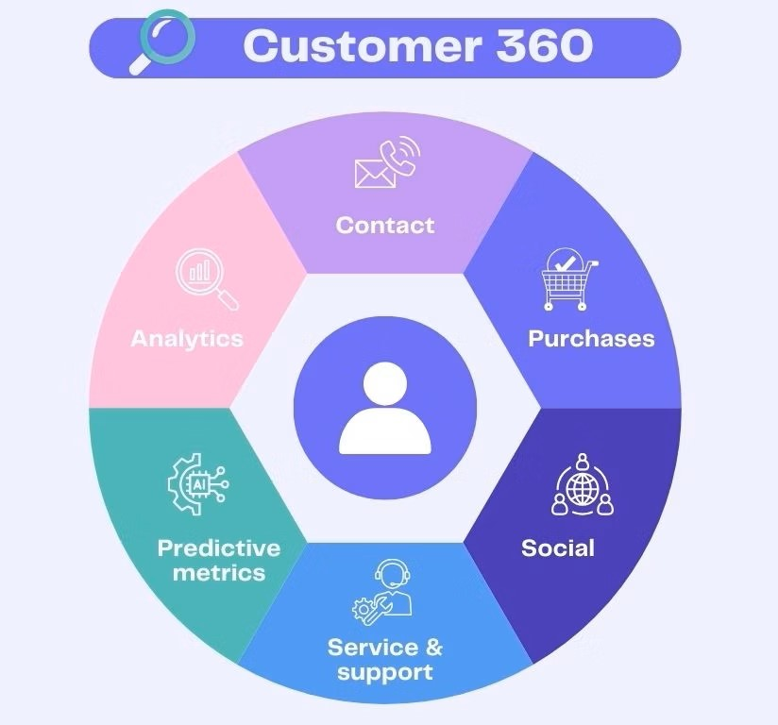
BENEFITS FOR BANKS
BETTER CUSTOMER UNDERSTANDING
FASTER SERVICE
DATA DRIVEN DECISIONS
EFFICIENT RISK MANAGEMENT

Slide 7
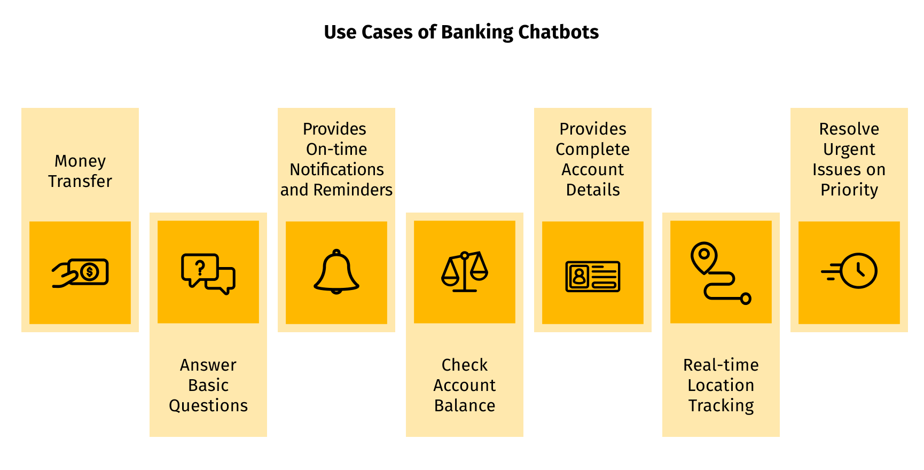
BENEFITS FOR CUSTOMERS
Personalized product offers
Faster issue resolution
More transparent banking
Smooth digital experience
More secure and reliable services

Slide 8
EXAMPLE DASHBOARD COMPONENTS
Pie chart showing account distribution
Graph of monthly transactions
Credit score meter
Alerts and recommendations
Customer lifetime value scoring
Recent interactions timeline
EXAMPLE

Slide 9

REAL WORLD USE CASES
ATM fraud detection based on unusual activity
Personalized loan offers for customers with good transaction patterns
Tracking customer complaints to improve service

Slide 10
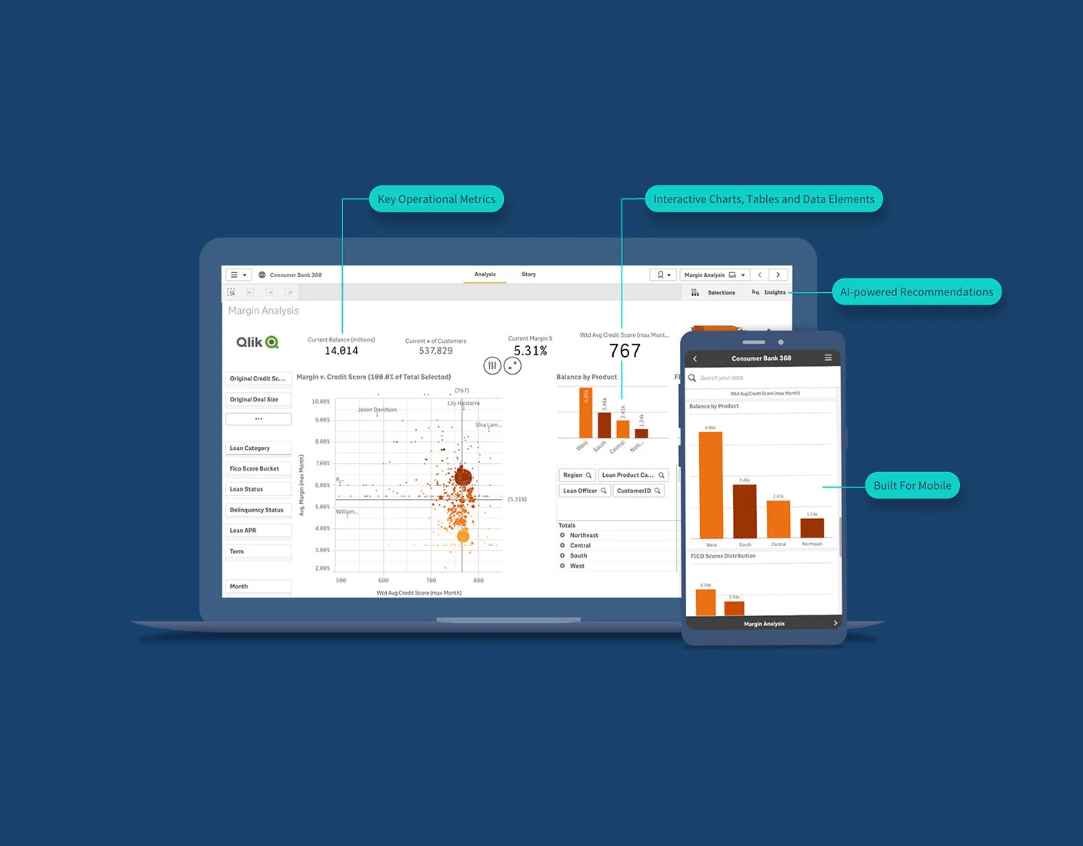
TECHNOLOGY USED
DATA WAREHOUSE
CRM SYSTEMS
AI & MACHINE LEARNING
CLOUD PLATFORMS
DATA VISUALIZATION TOOLS

Slide 11
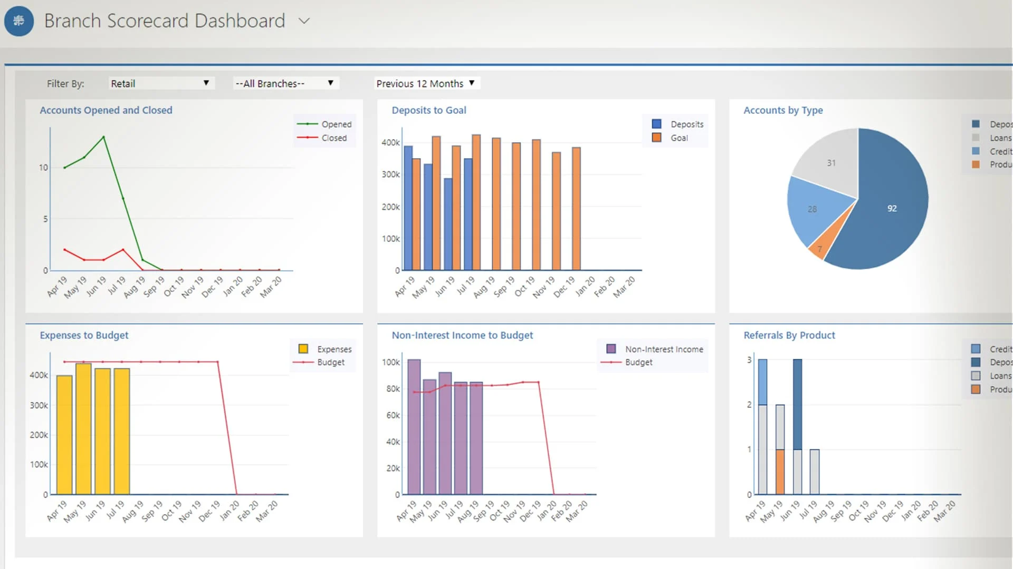
CHALLENGES
DATA PRIVACY
INTEGRATION OF MULTIPLE SYSTEMS
MAINTAINING REAL TIME UPDATES
ENSURING ACCURACY OF CUSTOMER DATA

Slide 12
CONCLUSION
A Customer 360 degree dashboard is becoming essential for modern banking .
It helps banks provide better, faster, and personalized services , while supporting secure and data driven banking operations.

